Slide 1
ANZ Data analysis
Kaiyue Wu

Slide 2
Data summary
This is synthesized transaction 3-month data of transaction information containing name, age, country etc.
However, the dataset has missing values and large range of some datapoints.
In order to make dataset more organized, we impute 0 to some NAN value and revised 1,0 accordingly to different status of [“authorized”, ”posted”].

Slide 3

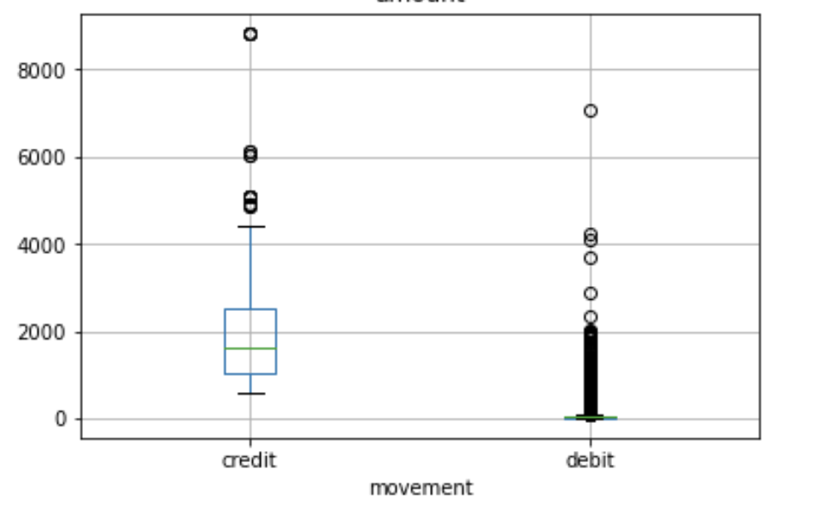

Amount Analysis
The transaction amount from(0.1, 8835.98)
Interesting…..
For different payment type
Credit players tend to higher transaction amount than debit customers
Debit players’ transaction amount cluster in $0-$2000, which indeed corresponds intuitive thought that debit customers are less purchase aggressive.

Slide 4
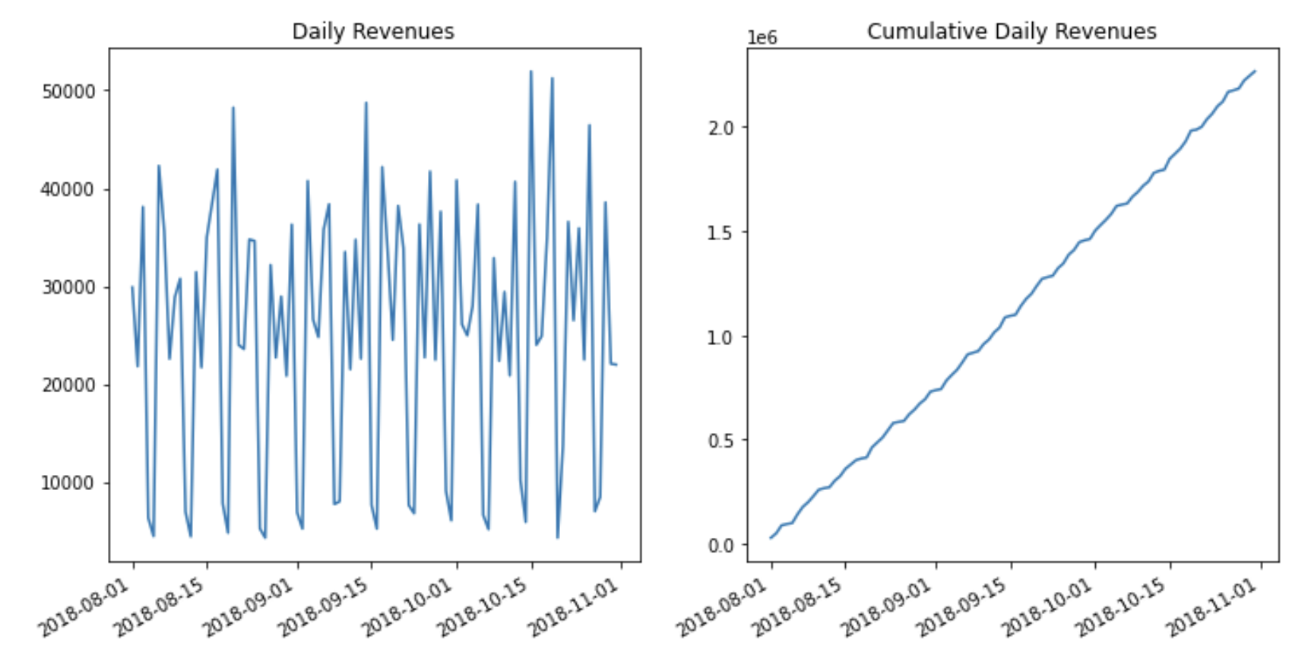
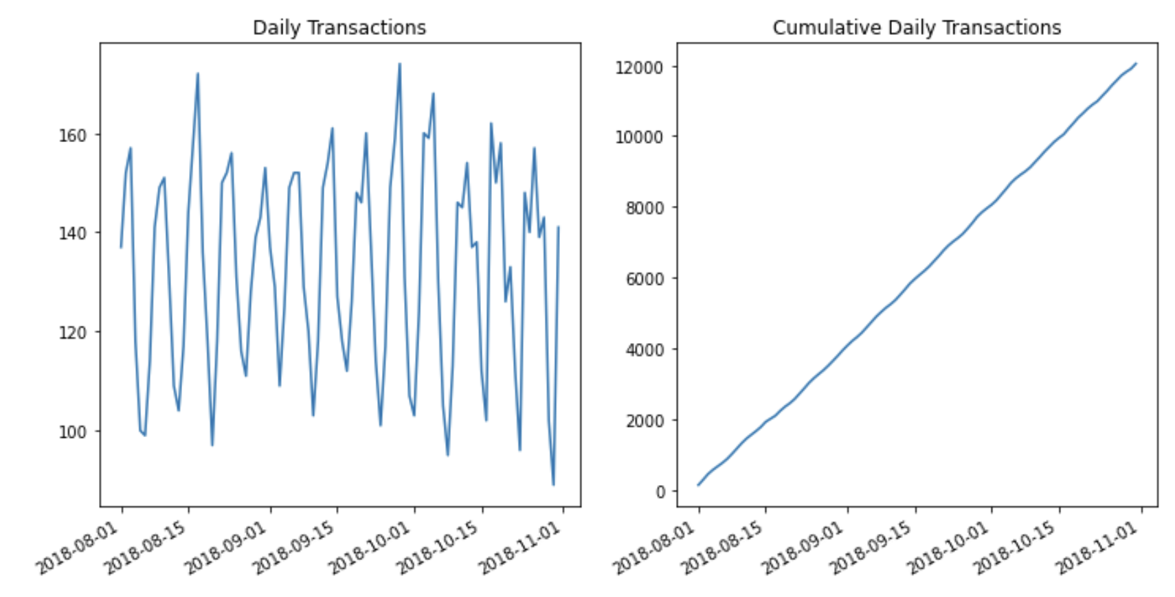
Daily Transaction
Daily transaction numbers and revenues are not constant

Slide 5
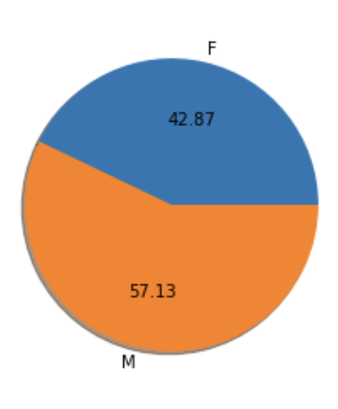
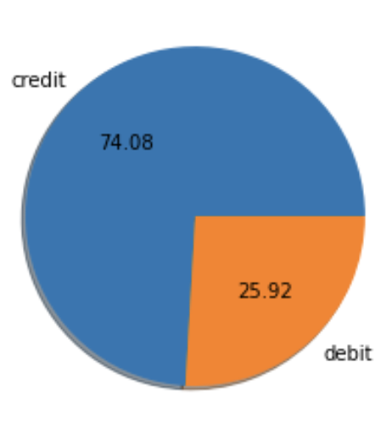
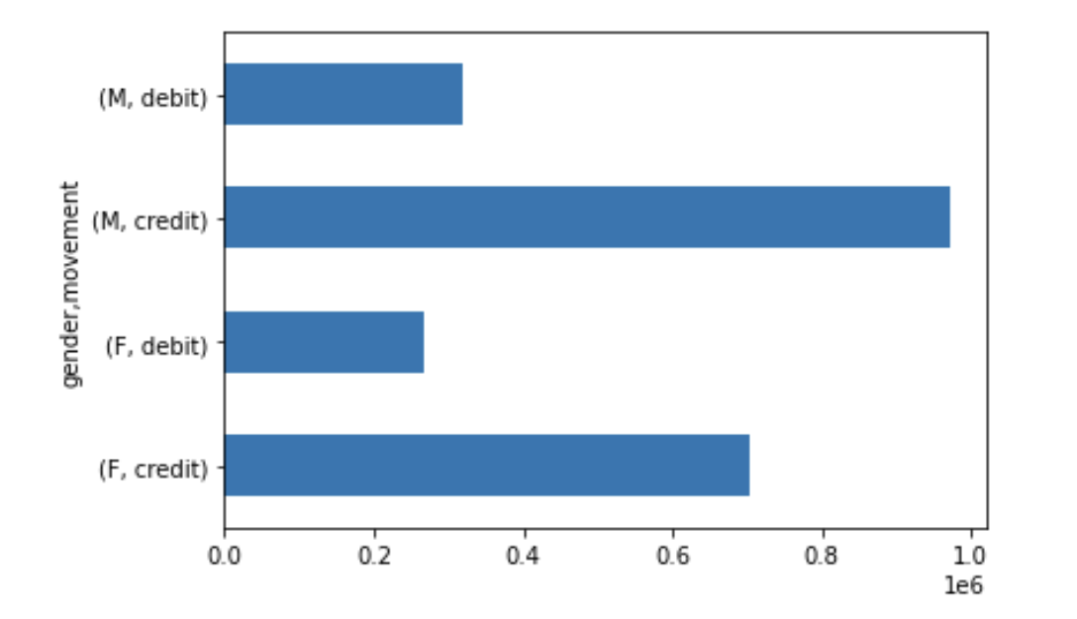
Revenues by segments
We found if we segment revenues by transaction type and gender, we can find:
Credit customers contribute more
Male customers contribute more
Among creditors and debits, male take more position in transactions.

Slide 6
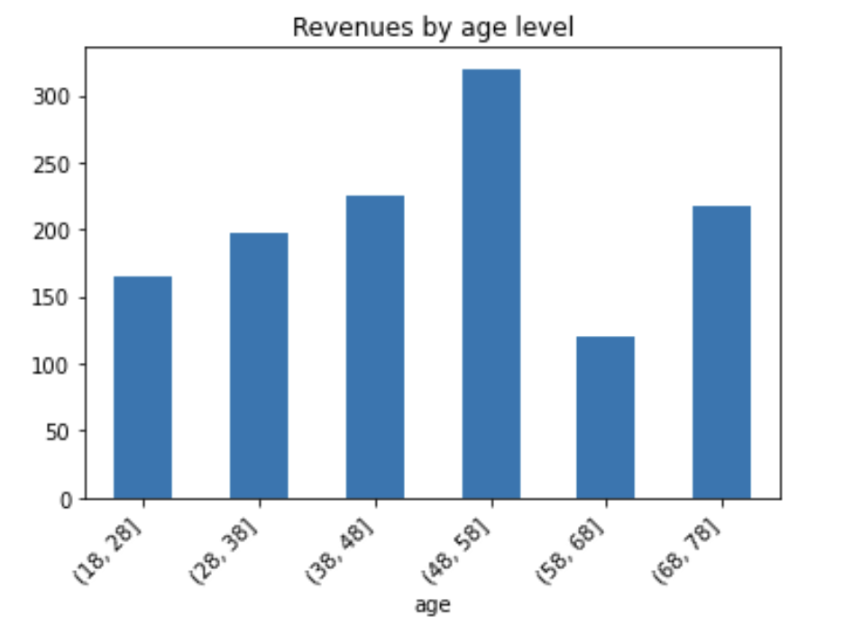
Revenue by age level
On 10- year interval, 48-58 mid-age customers tend to spend more comparing to others
Followed by 38-48, 68-78 customer groups.
However, the 58-68 age group spend least, which intuitively raises the question, why?
In general cases, such customers are active in terms of work-flexibility and aggregated income, but why are they spending the least?

